Slide 1
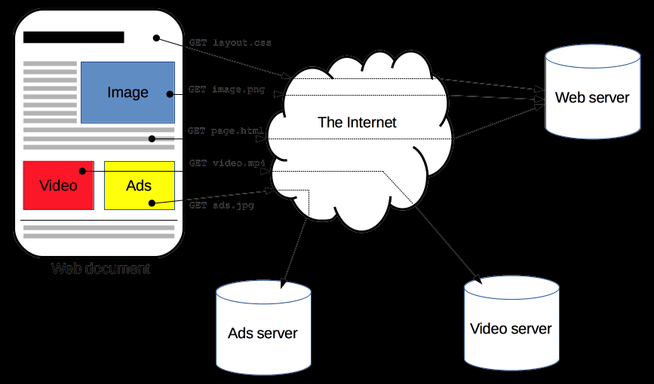
An Introduction into HTTP/3
BY ASLAM PATEL
Notes:
HTTP is a protocol which allows the fetching of resources, such as HTML documents. It is the foundation of any data exchange on the Web and it is a client-server protocol, which means requests are initiated by the recipient, usually the Web browser. A complete document is reconstructed from the different sub-documents fetched, for instance text, layout description, images, videos, scripts, and more.

Slide 2
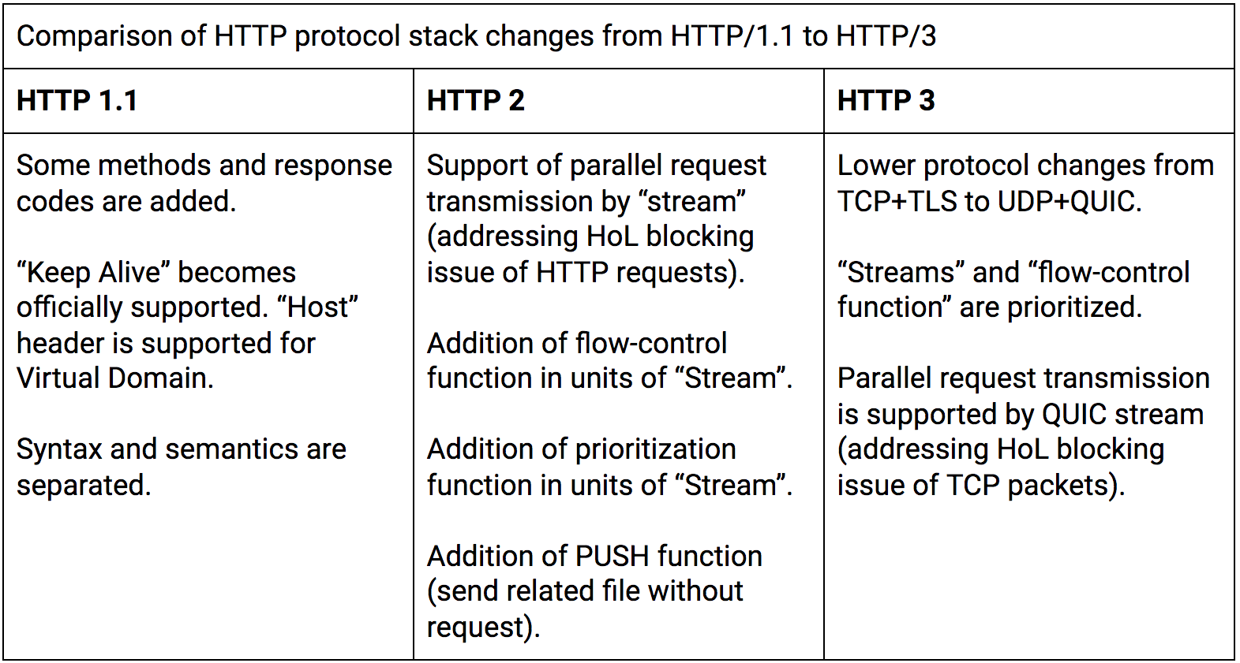
Introduction
HTTP/3 is the imminent main version of the HTTP protocol which is currently used to exchange information on the internet
HTTP/3 is the third and upcoming major version of the Hypertext Transfer Protocol used to exchange information on the World Wide Web, alongside HTTP/1.1 and HTTP/2
HTTP/3 is not susceptible to “head of line” blocking which arises from TCP. As HTTP/3 has other optimization it can have a superior performance to is predecessors.
Notes:
The basic transport mechanism of HTTP has mostly kept the same throughout the growth of the Internet and HTTP. HTTP, on the other hand, has struggled to deliver a seamless, transparent online surfing experience as internet traffic has increased as a result of widespread public adoption of mobile device technologies. And, as the need for real-time applications grows,

Slide 3
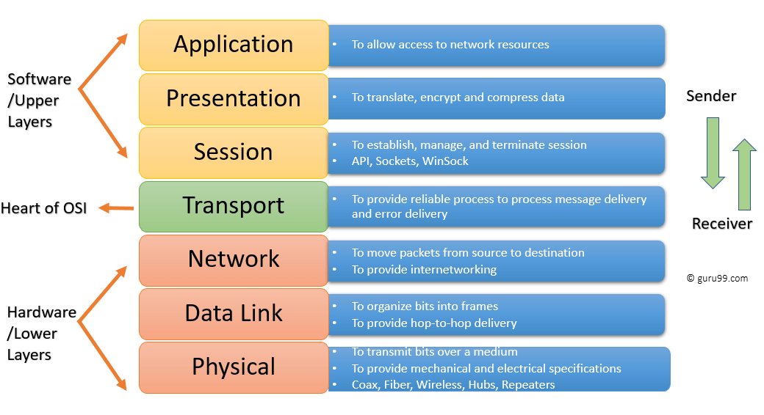
History of HTTP/3
HTTP/3 is still based on the previous draft which was known as “HTTP over QUIC”
QUIC is the transport layer network protocol which was initially developed by Google where congestion control is performed over UDP.
Application layer is where we will have HTTP and transport is where we will have UDP and TCP
Notes:
The HTTP/3 application mapping to the QUIC transport layer is known as HTTP/3. This moniker was made official in draught version 17 which was proposed in late October 2018 and discussed and reached a rough agreement during the IETF 103 conference in Bangkok in November.

Slide 4
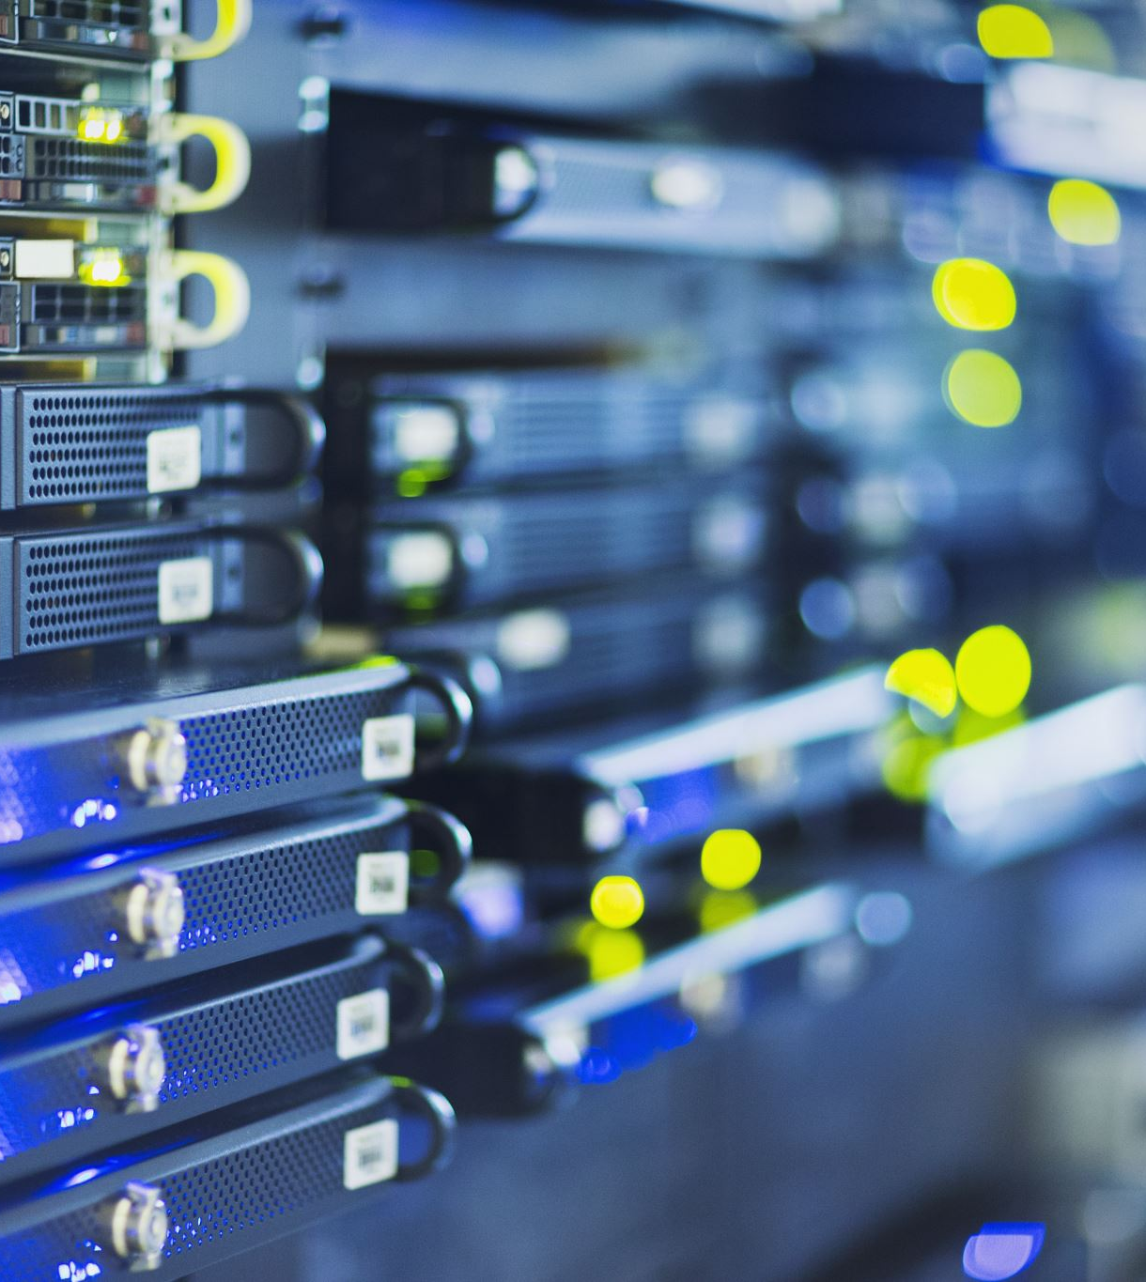
Quick review on TCP
One of the most important protocols in the Internet protocol family is the Transmission Control Protocol. Its origins may be traced back to the first network implementation, when it was used to supplement the Internet Protocol.
TCP has a main aim of ensuring data doesn’t get corrupted and arrives In order along with flow and congestion control

Slide 5
A quick review on UDP
The User Datagram Protocol is a basic part of the Internet protocol suite in computer networking. Computer programmes can use UDP to transfer messages, known as datagrams, to other hosts on an Internet Protocol network.
It aims to be faster that TCP by only providing check-sums and no handshaking, guarantee of delivery and duplicate protection

Slide 6
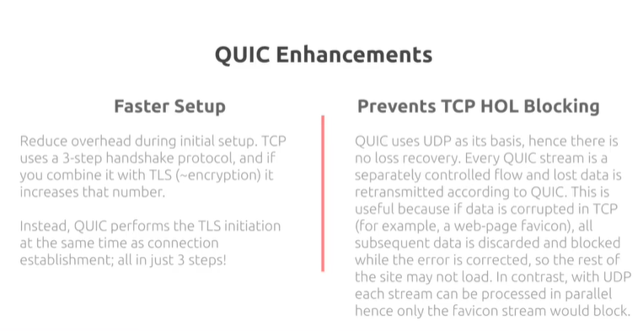
QUIC Protocol
QUIC protocol has the main aim to be nearly the same as TCP connection but with reduced latency and leverages to changes..
Notes:
Quick UDP Internet Connection is a novel network protocol that encrypts the transport layer. QUIC was created to improve the security, efficiency, and speed of HTTP transmission. Theoretically, QUIC has integrated all of the finest features of TCP connections and TLS encryption on UDP.

Slide 7
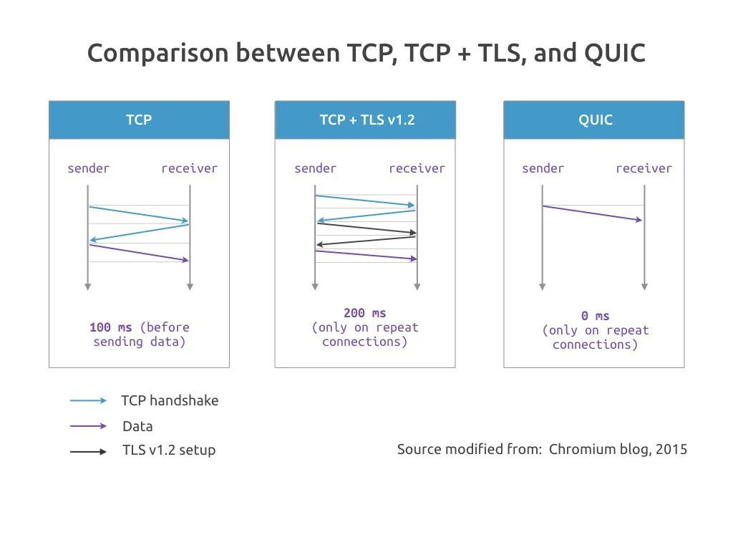
Comparison of protocols
TCP was chosen as the foundation for the Internet because it is a dependable transmission mechanism. TCP, on the other hand, excels in terms of dependability but falters in terms of the number of round trips necessary to create a secure connection.
Before a browser can request a web page, it must first establish a secure connection. In order to make an encrypted https connection, secure online surfing normally entails interacting over TCP and negotiating TLS.
Notes:
QUIC outperforms TCP in terms of time for transfer and average bandwidth used. When high delay, packet loss, and high bandwidth, QUIC will perform much better than TCP including time for transfer and throughput. Under favorable conditions, The QUIC will be more stable than TCP.

Slide 8
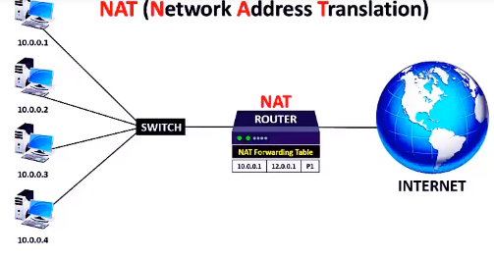
Network Address Translation
Network address translation is a method of translating one IP address space to another by changing network address information in packets' IP headers while they are in transit through a traffic routing device.
The importance of NAT in firewall security cannot be overstated. It reduces the number of public addresses used within a company and provides for tighter access control to resources on both sides of the firewall.
Notes:
QUIC (Quick UDP Internet Connections) is a new encrypted-by-default Internet transport protocol, that provides a number of improvements designed to accelerate HTTP traffic as well as make it more secure, with the intended goal of eventually replacing TCP and TLS on the web.

Slide 9
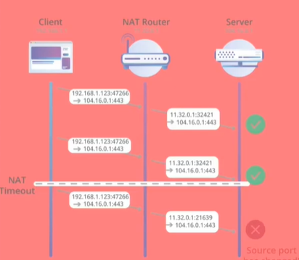
NATs & QUIC
NATs keep track of the TCP connection and observer the SYN, ACK AND FIN packets to determine the lifecycle of the connection
For QUIC this isn’t possible as most of the NATs deployed wont understand the format resulting in it to fall back to UDP.
As we know UDP has less handling power making it less precise
Notes:
On the diagram we have two green and one red. There was a nat timeout so a nat assigned a new port so server could say this is something else and where has it come from.

Slide 10
How are NATs handled by QUIC?
QUIC attempts to overcome this issue by introducing a connection ID which will be carried by the packets within QUIC. This will play a vital role for identifying the packets sent and received.
The end points will ultimately be the devices to use these IDs
Ultimately this will aid the connection migrations the most as if there is mobile connection which has been changed the download will not be broken.

Slide 11
How are TCP safety mechanisms deployed in QUIC?
ERROR CORRECTION | OVERLOAD CONTROL | CONGESTION CONTROL
Forward error correction uses a XOR based error correction system. Which ultimately sends redundant backups | TCP attempts to sent data as quick as it can. It the situation where a packet is lost retransmission will occur. However TCP reduces the size of the window. The same occurs with QUIC during load peaks | This is the exact same as TCP however it has some variation with different algorithms such as NEW-RENO
Notes:
Theoretically, QUIC has taken all the best qualities of TCP connections and TLS encryption and implemented it on UDP

